Slide 1
Topic: Multi Agent Deriverl(DRL)
SV: Hạ Huy Thiện MSV :22014474

Slide 2
INTRODUCTION
PROJECT OBJECTIVES
ENVIRONMEMNT
AlGORITHMS
REWARD AND SATE
RESULTS
CONCLUSION

Slide 3
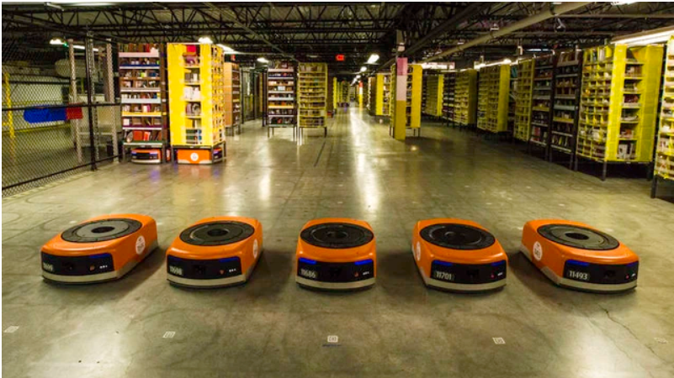
I. Introduction
The multi-agent delivery system is a model that uses multiple autonomous robots to perform pickup and delivery tasks in a simulated environment such as a warehouse. Each robot is controlled by deep reinforcement learning algorithms such as DQN and DDQN, allowing it to learn optimal navigation, avoid collisions, and coordinate effectively with other robots.

Slide 4
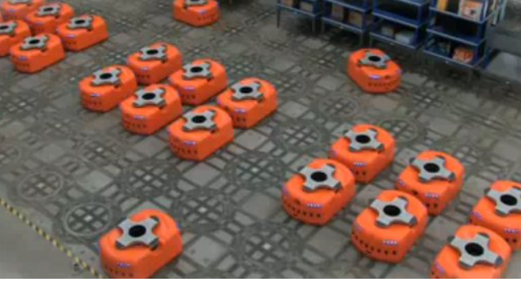
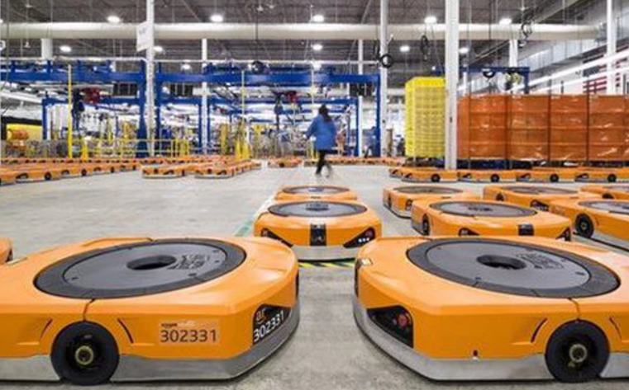
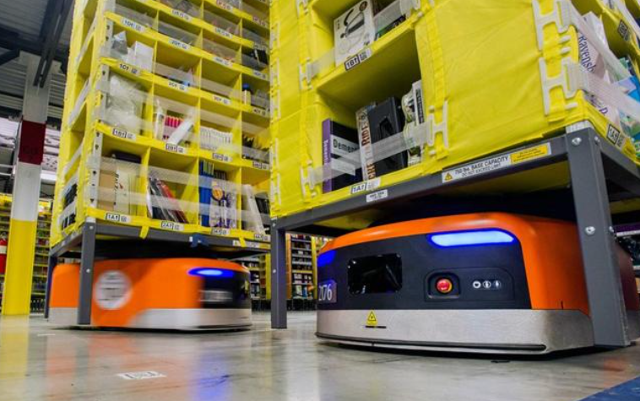
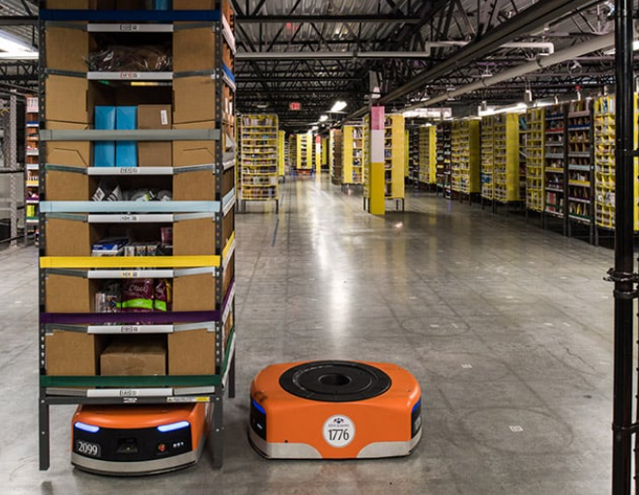
ROBOTS

Slide 5
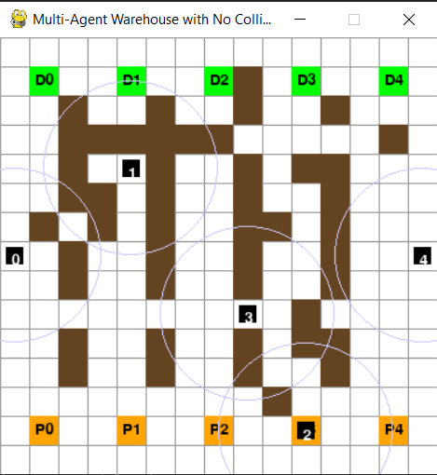
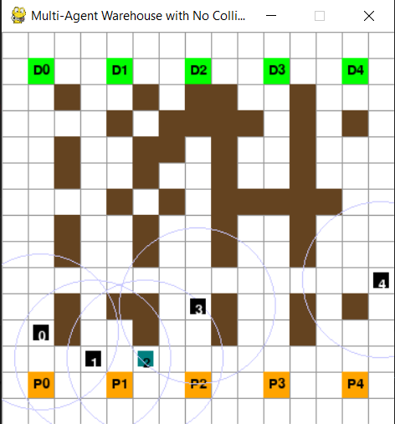
II.PROJECT OBJECTIVES
-Simulate a multi-agent delivery system using autonomous robots
- Build an interactive environment including map, obstacles, pickup and delivery points
-Apply Deep Reinforcement Learning techniques:
DQN (Deep Q-Network)
DDQN (Double Deep Q-Network)
From there, the robot learns to select pickup and delivery points that yield the highest expected rewards.

Slide 6
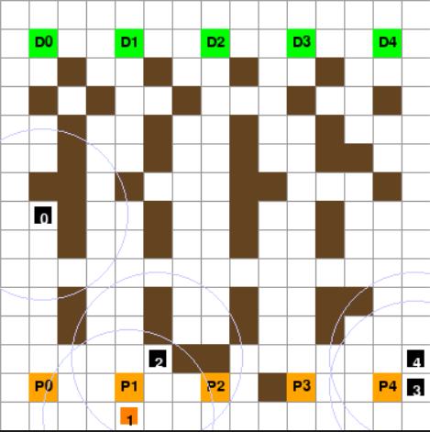
III. Environment
This is a visual simulation of the multi-agent delivery environment:
P0, P1, P2, P3, P4 (orange cells): represent the pickup points
D0, D1, D2, D3, D4 (green cells): represent the delivery points
Brown blocks: represent walls or obstacles
Faint blue circles around robots: indicate their communication range

Slide 7
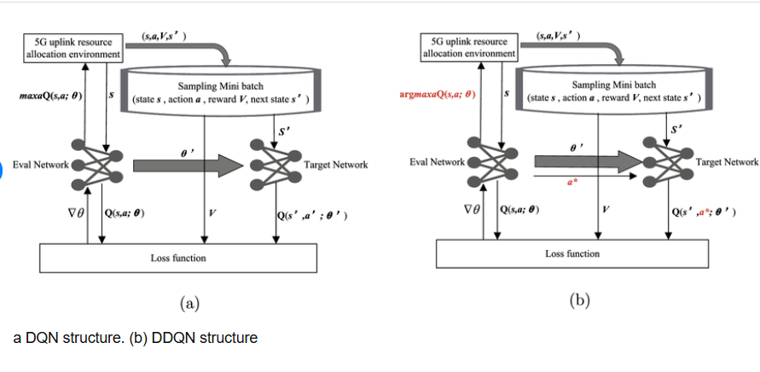
IV. Algorithms
DQN (Deep Q-Network): In my system, DQN is used to train the agents to learn optimal control policies through interaction with the environment. By combining the Q-learning algorithm with deep neural networks, the robots can make appropriate movement decisions in large state spaces without requiring a predefined model of the environment.
DDQN (Double DQN): In addition to DQN, I also implemented the DDQN algorithm to improve training stability. DDQN helps reduce overestimation of action values by using two separate neural networks: one for selecting actions and another for evaluating them. As a result, the learning process of the agents becomes more stable and yields better performance in the delivery simulation environment.

Slide 8
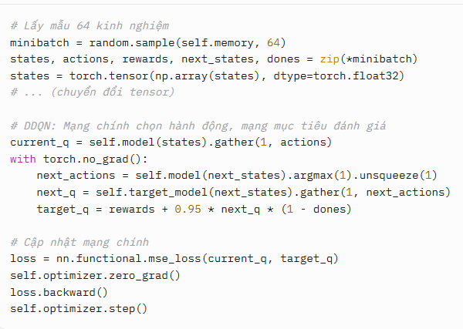
IV. Algorithms Main Steps in Implementing DDQN and DQN Main Steps in Implementing DDQN - Sample 64 experiences from the replay memory -Use the main network to select the best action for the next state -Use the target network to compute Q-value: target_q = rewards + 0.95 * next_q * (1 - dones) -Update the main network using MSE loss and the Adam optimizer lr = 1e-5

Slide 9
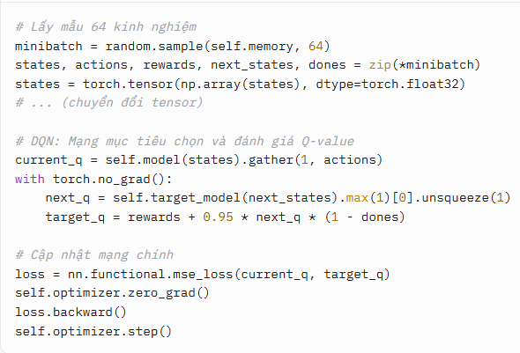
IV. Algorithms Main Steps in Implementing DDQN and DQN Main Steps in Implementing DQN - Sample 64 experiences from the replay memory -The target network selects and evaluates the maximum Q-value for the next state -Compute: target_q = rewards + 0.95 * next_q * (1 - dones) -Update the main network using MSE loss and the Adam optimizer lr = 1e-4

Slide 10
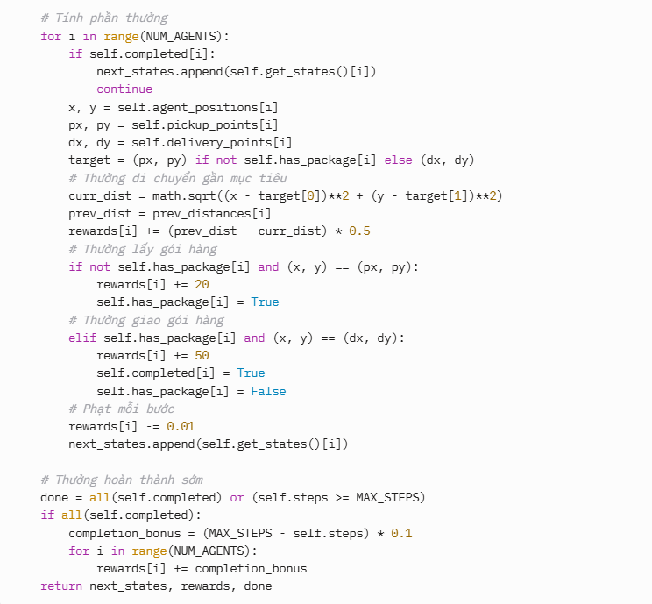
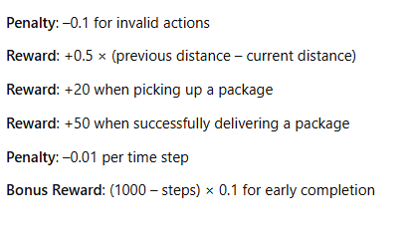
V.REWARD AND SATE REWARD:

Slide 11
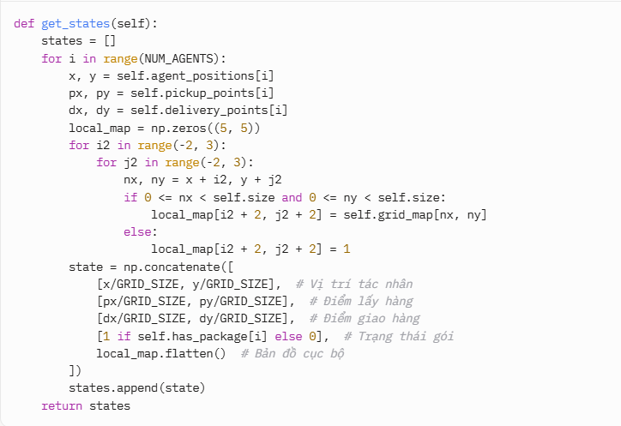
V.REWARD AND SATE SATE:
Agent coordinates (2 values): [x/GRID_SIZE, y/GRID_SIZE] – normalized position (0 to 1) on a 15x15 grid. Pickup point coordinates (2 values): [px/GRID_SIZE, py/GRID_SIZE] – location of the pickup point. Delivery point coordinates (2 values): [dx/GRID_SIZE, dy/GRID_SIZE] – location of the delivery point. Package status (1 value): [1 if self.has_package[i] else 0] – 1 if the agent is carrying a package, 0 otherwise. Local map (25 values): 5x5 matrix around the agent, with value 1 for walls/edges and 0 for empty cells.

Slide 12
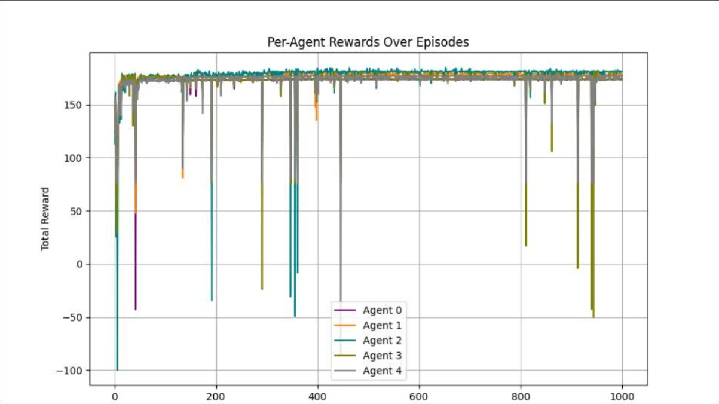
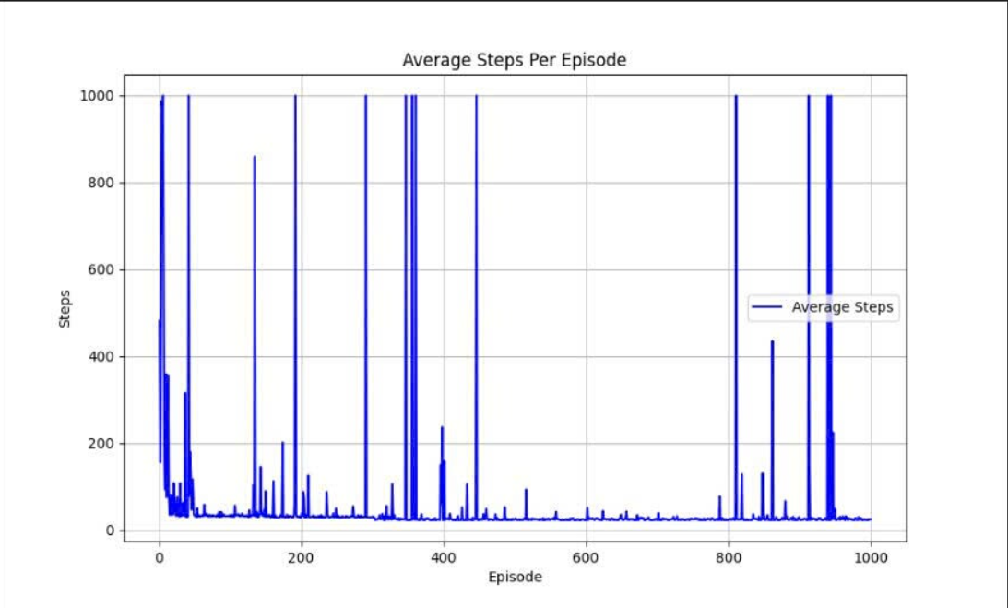
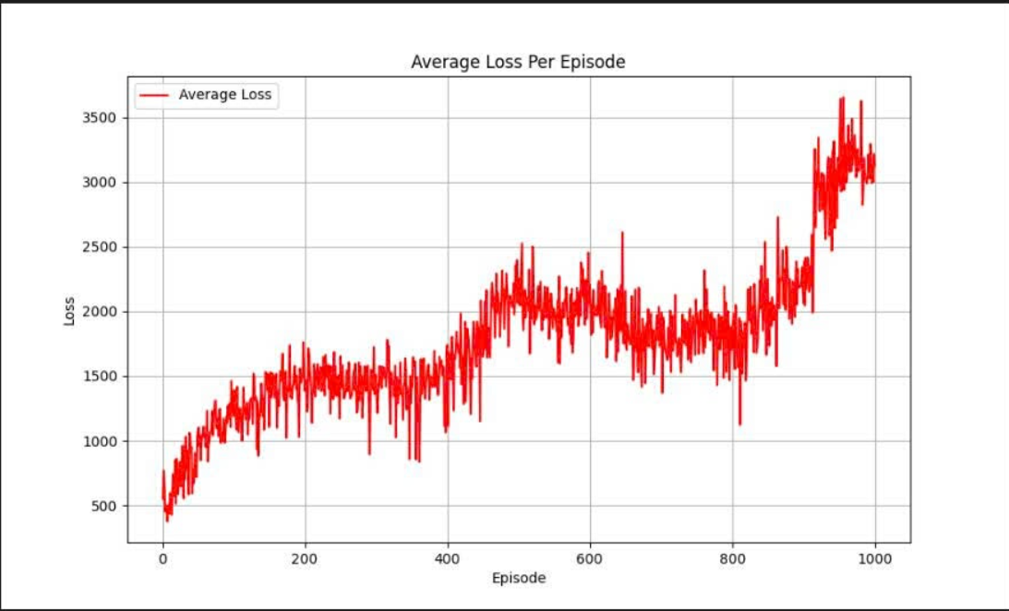
VI.RESULTS
RESULTS WITH DQN
LEARING RATE = 1e – 4

Slide 13
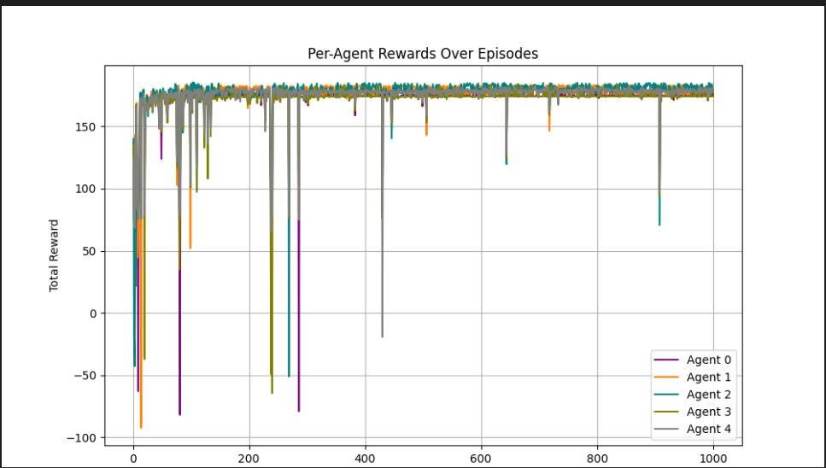
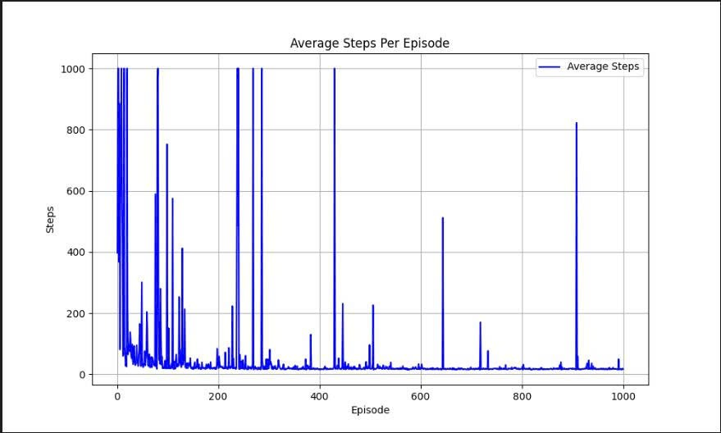
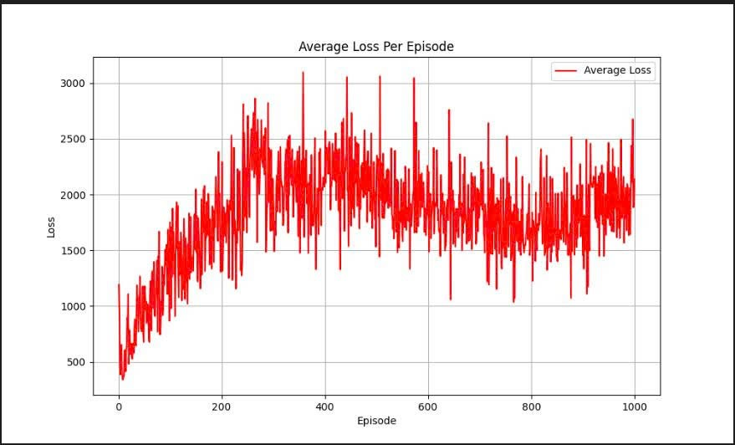
VI.RESULTS
RESULTS WITH DDQN
LEARING RATE = 1e – 4

Slide 14
VII Conclusion
This project compared DQN and DDQN in a multi-agent delivery system. Results showed that DDQN provided better stability and performance due to reduced Q-value overestimation.

Slide 15
THANK YOU!

